Slide 1

Master Your Minutes
The POWER Method for Effective Time Management
30-minute training session for working professionals seeking actionable time-management skills

Slide 2
The Time Crisis Reality Check
2.5
67%
56
$37B
Hours wasted daily
Feel overwhelmed
Daily interruptions
Lost productivity
Average knowledge worker loses this much productive time every single day
Professionals struggling with workload management
Average number of disruptions per workday
Annual cost of poor time management nationwide
The million-dollar question: What if you could reclaim just one hour of that lost time?

Slide 3

What You'll Master Today
1
Identify your top 3 time-wasting behaviors
2
Apply the POWER method to daily tasks
3
Create your personalized 15-minute planning routine
Using our proven self-assessment tool to pinpoint exactly where your minutes disappear
Master the 5-step system that transforms chaos into organized productivity
Build a morning ritual that sets you up for success every single day

Slide 4
Introducing the POWER Method
Five simple steps that will revolutionize how you manage your time
P
O
W
Prioritize
Focus on what matters most
Organize
Design your ideal day
Weed Out
Eliminate time drains
E
R
Execute
Take focused action
Review
Learn and improve

Slide 5
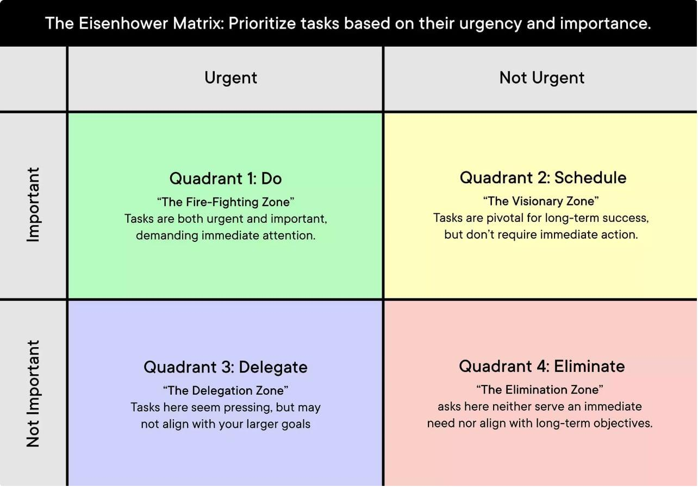

P - Prioritize: Focus on What Matters Most
The Magic Question
"If I could only do 3 things today, what would create the biggest impact?"
Use the Eisenhower Matrix to categorize every task:
Quadrant 1: Urgent + Important (Crisis mode)
Quadrant 2: Important + Not Urgent (Prevention)
Quadrant 3: Urgent + Not Important (Interruption)
Quadrant 4: Not Urgent + Not Important (Time waste)
Start with Quadrant 2 - this is where success lives!

Slide 6
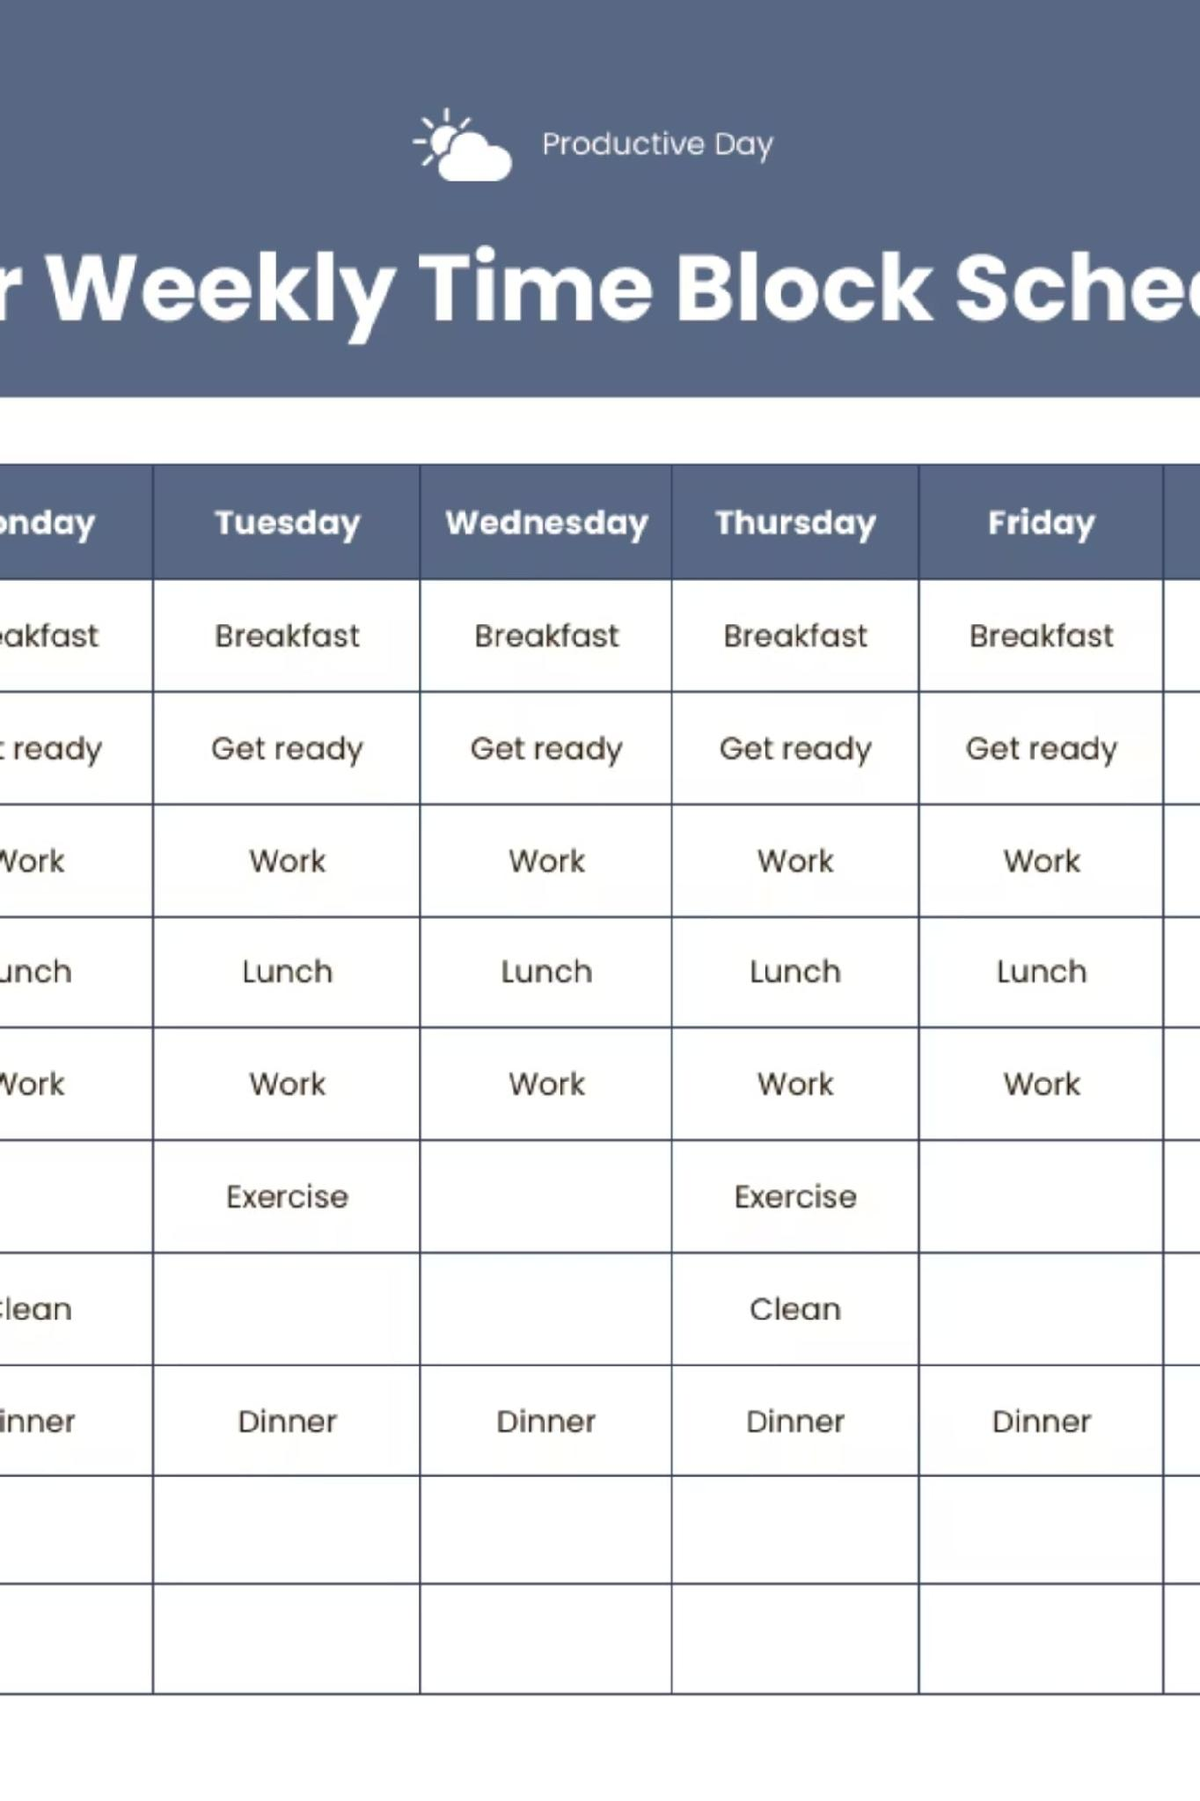
O - Organize: Design Your Day
Master Time Blocking
01
02
Deep Work Blocks
Communication Windows
Schedule 2-3 hour chunks for your most important tasks when your energy peaks
Batch process emails and calls into focused 30-45 minute sessions
03
Buffer Time
Build in 15-30 minute cushions between activities for unexpected priorities
Golden Rule: Protect your prime time for your prime tasks - no exceptions!

Slide 7

W - Weed Out: Eliminate Time Drains
Unnecessary Meetings
Social Media Rabbit Holes
Ask yourself: "Can this be an email?" Before accepting any meeting invitation.
Use app timers and designated browsing windows. Your future self will thank you.
Perfectionism Paralysis
Saying Yes to Everything
Remember: Done is better than perfect. Progress beats perfection every time.
Master the gracious no. Every yes to something unimportant is a no to something vital.

Slide 8
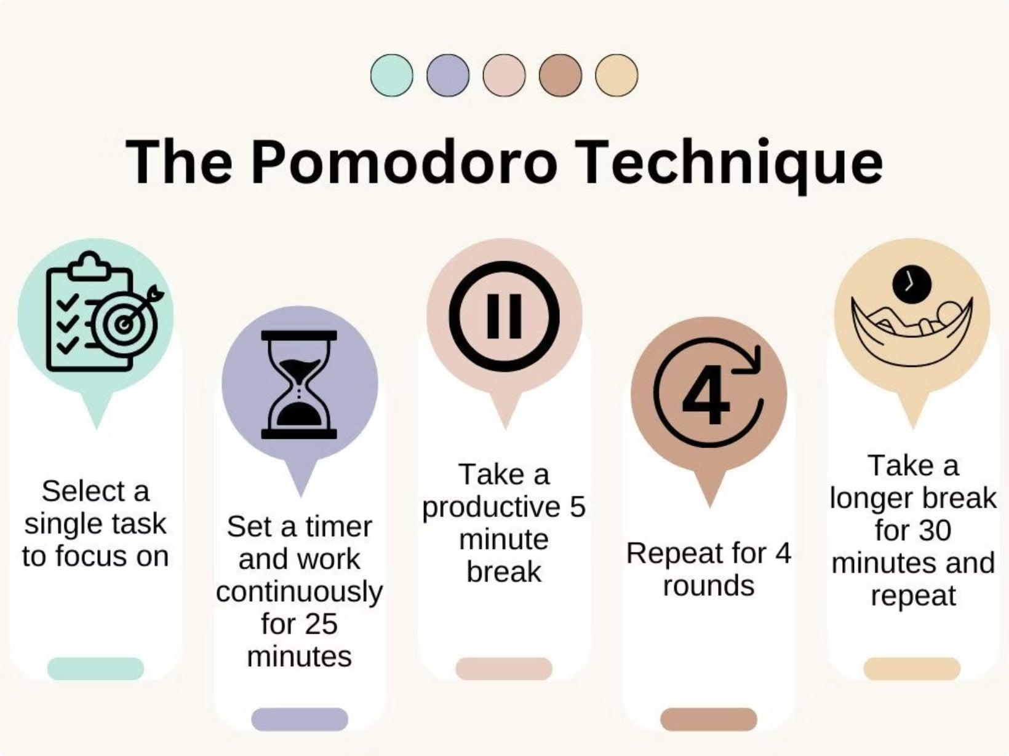
E - Execute: Take Action Now
The 2-Minute Rule
If a task takes less than 2 minutes, do it immediately. Don't add it to your to-do list - just do it!
The Pomodoro Power
Work in focused 25-minute sprints followed by 5-minute breaks. This keeps your brain fresh and productive.
Beat Procrastination
Start with the smallest possible step. Sometimes that means just opening the document or making one phone call.

Slide 9

R - Review: Learn and Improve
Daily 5-Minute Reflection
1
End each day by asking: What worked well? What would I do differently? What are tomorrow's top 3 priorities?
2
Weekly Power Hour
Dedicate one hour each week to bigger picture planning, reviewing your systems, and adjusting your approach.
Consistent reflection turns experience into expertise. Make it non-negotiable!

Slide 10


Case Study: Sarah's Transformation
Meet Sarah: Marketing Manager and Working Parent
BEFORE POWER (Chaos Mode)
AFTER POWER (Organized Mode)
6 AM: Rush to work, forgot lunch again
9 AM: Lost 3 hours in "urgent" emails
2 PM: Back-to-back meetings with no breaks
6 PM: Finally start important project
6 AM: 15-minute planning, prepared lunch
9 AM: 2 hours deep work on key project
11 AM: 30-minute email batch processing
3 PM: Strategic meetings only
Result: 10-hour days, constant stress, missing deadlines
Result: 8-hour focused days, promoted within 6 months

Slide 11
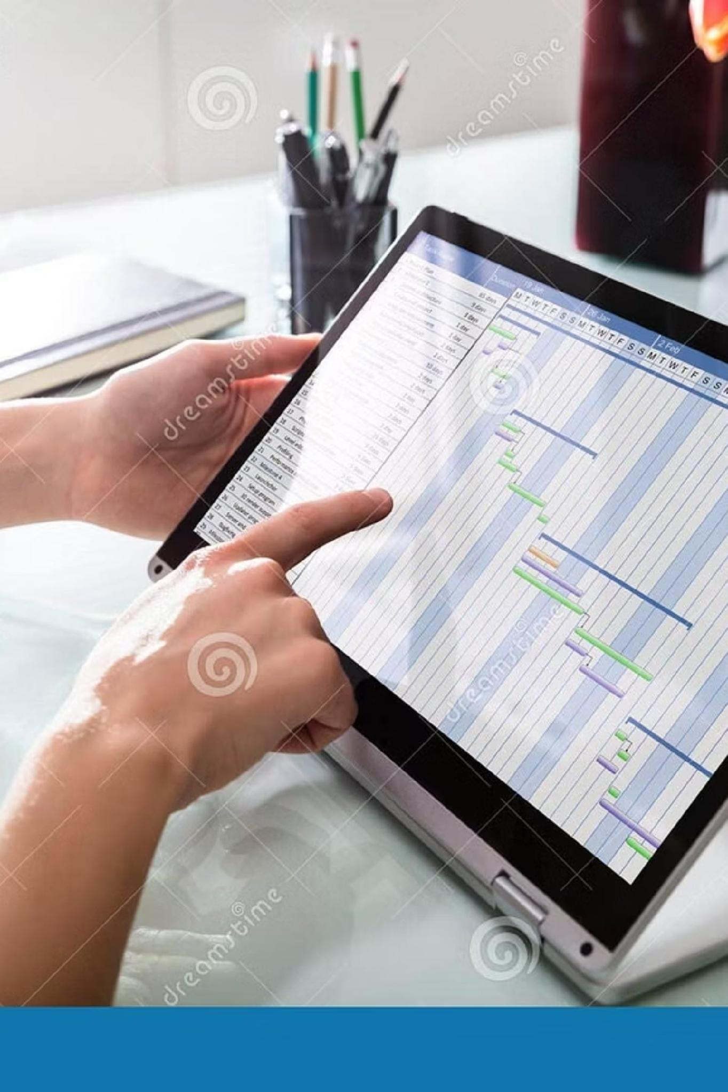
Time Audit Challenge: Find Your Time Wasters
Your Mission (4 minutes total):
List yesterday's activities (2 minutes)
Mark each as High/Medium/Low value
Identify your #1 time waster
Share findings with a partner (2 minutes)
Common Time Wasters Discovered:
Unscheduled interruptions (23%) • Excessive email checking (18%) • Unclear priorities (15%) • Multitasking (12%)

Slide 12
Your Daily POWER Planner Template
P - PRIORITIES
O - ORGANIZE
W - WEED OUT
My top 3 priorities for today
Most important task (MIT)
Impact rating (H/M/L)
Time blocks scheduled
Deep work period protected
Communication windows set
What I'll eliminate today
What I'll delegate
What I'll say no to
E - EXECUTE
R - REVIEW
2-minute tasks to do now
Pomodoro sessions planned
Quick wins identified
Evening reflection questions
Tomorrow's preparation
Weekly review scheduled

Slide 13
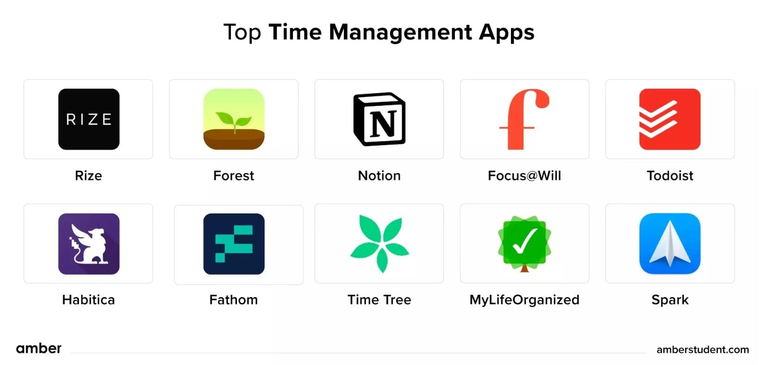
Your Resource Toolkit
Templates & Worksheets
Daily POWER Planner template
Time audit worksheet
Quick reference card
30-day implementation guide
Recommended Apps
Todoist: Task management
RescueTime: Time tracking
Forest: Focus and concentration
Toggl: Time tracking
Essential Reading
Getting Things Done by David Allen
Atomic Habits by James Clear
Deep Work by Cal Newport
The 7 Habits by Stephen Covey

Slide 14





Your 4-Week Implementation Roadmap
Tomorrow: Start Strong
Begin with 15-minute morning planning using your POWER template
Week 1: Foundation
Master prioritization (P) and organization (O) - build the habit
Week 2: Refinement
Add elimination strategies (W) and execution techniques (E)
Week 3: Integration
Implement daily review process (R) for continuous improvement
Week 4: Mastery
Full POWER method integration - you're now a time management pro!

Slide 15

Your Power Commitment
Take Action Now!
15-Second Challenge - Share with the group:
1
ONE thing you'll do differently tomorrow morning
2
Find your accountability partner
Exchange contacts with someone in this room for mutual support
Be specific - what time will you start your 15-minute planning session?
Remember: Small changes in planning lead to big results in productivity. You now have the POWER to master your minutes and transform your day!
Follow-up: 7-day check-in survey to track your progress and celebrate your wins

